Slide 1
EBONYI STATE UNIVERSITY
ACADEMIC STAFF MENTORSHIP WORKSHOP
ACADEMIC CAPACITY BUILDING FOR GLOBAL RELEVANCE
DR. B. I. UNEKE
DIRECTOR DRIC
DATE: 27TH SEPTEMBER 2019
TIME: 11AM
VENUE: LAW AUDITORIUM CAS CAMPUS

Slide 2
ACADEMIC CAPACITY BUILDING FOR GLOBAL RELEVANCE
Capacity building is defined as the process of developing and strengthening
skills, instincts, abilities, processes and resources
that organizations and communities need to survive, adapt and thrive in a fast changing world.

Slide 3
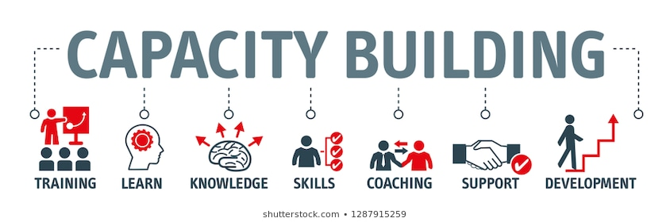
Capacity Building

Slide 4

Interest in research

Slide 5
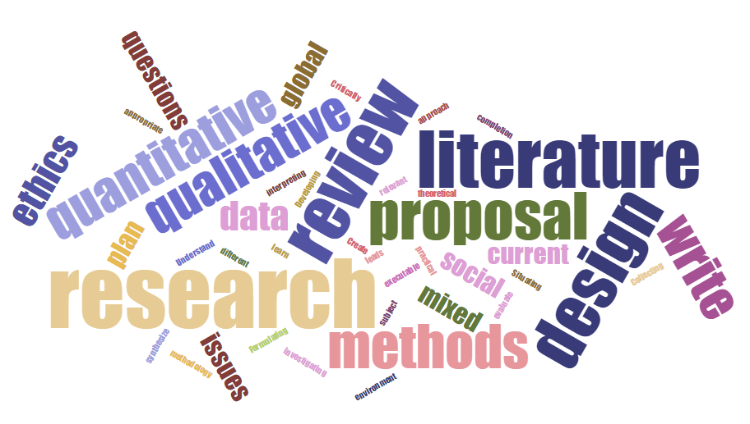
Skill acquisition in research methods/ techniques

Slide 6
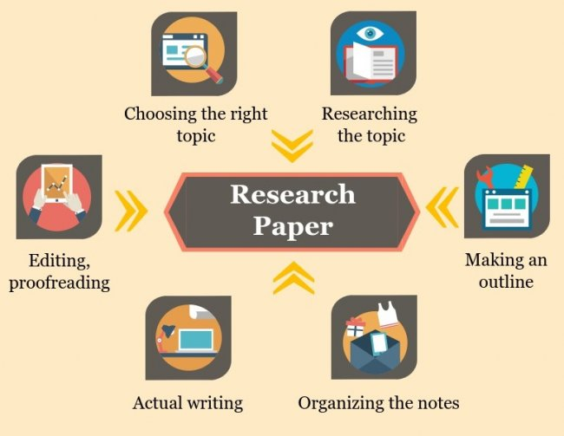
Skill in research paper writing

Slide 7

Skill in grantsmanship

Slide 8

Sufficient interest to access vital information online

Slide 9
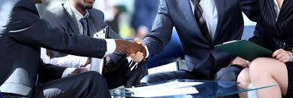
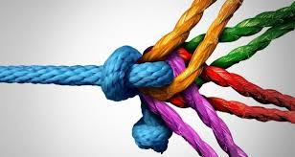
Local and international partnership

Slide 10

Participation in local and international workshops and Conferences

Slide 11
Thank you

